Slide 1
TUN Data Challenge
STUDENTS:
Muhammad Fawad Akbar Khan
University of Engineering & Technology, Peshawar
m.fawad_akbar@live.com
Mian Ibad Ali Shah
University of Engineering & Technology, Peshawar
mianibad_kakakhel@outlook.com
FACULTY:
Prof. Laiq Hasan
University of Engineering & Technology, Peshawar
laiqhasan@uetpeshawar.edu.pk
NOTE: PLEASE ZOOM IN THE SLIDES TO SEE THE DATA MORE CLEARLY

Slide 2
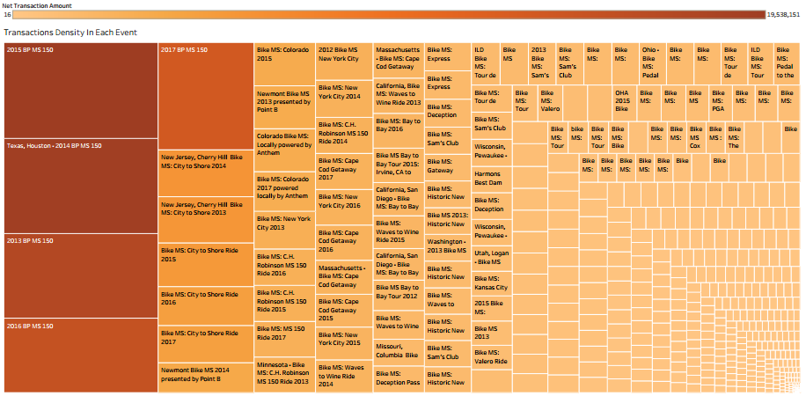
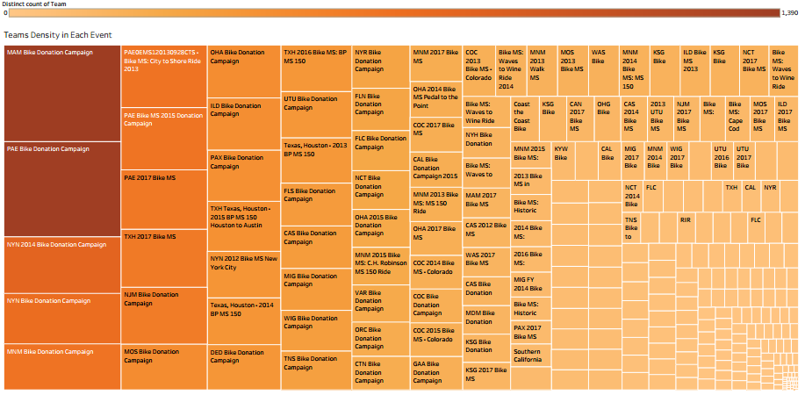
Bike MS Summary Sheet (5 Years)
Top Corporations vs Net Transactions
Donor Employer .
BP Foundation Matching Gifts
1,499,670
Top Performing Teams
Team Name
TXH Anonymous Donor CIC
Harmons
1,011,304
Team BP
NetTransactionAmount TotalNumberofParticipants
1,726
5,510,542
752,875
HoustonianClub NetTransactionAmount ^{Hammerheads} TotalNumberofParticipants
312
3,038,551
Fidelity Charitable Gift Fund
730,297
ConocoPhilips NetTransactionAmount
2,053,094
TotalNumberofParticipants
598
Johnson & Johnson Matching Gifts
674,070
SaintArnoldBike NetTransactionAmount
1,928,840
^{Team} TotalNumberofParticipants
1,211
EOG Resources Matching Gifts
544,244
RawHinies
NetTransactionAmount TotalNumberofParticipants
311
1,838,981
Bank of America Charitable Foundation
535,410
Team NobleDriling NetTransactionAmount
1,775,375
BHP Billiton Petroleum Matched Giving
521,372
TotalNumberofParticipants
231
Team Calpine NetTransactionAmount
1,737,525
TotalNumberofParticipants
481
Shell Oil Company Matching Gifts
MNM Anonymous Donor CIC
484,934
ExonMobilCycling NetTransactionAmount ^{Team} TotalNumberofParticipants
535
1,651,278
471,400
LiamsLuckyCharms NetTransactionAmount
1,55 3,935
PAX Anonymous Donor CIC
464,505
TotalNumberofParticipants
341
Team Donaldson NetTransactionAmount
1,545,66 5
PAE Anonymous Donor CIC
454,963
TotalNumberofParticipants
833
Team LeftHand NetTransactionAmount
1,447,196
Primal Wear Inc
453,625
TotalNumberofParticipants
592
ConocoPhillips Matching Gift Program
Jewish Community Foundation
396,274
389,555
Team Shel
NetTransactionAmount TotalNumberofParticipants
782
1,325,107
UPHS/PENN
NetTransactionAmount TotalNumberofParticipants
857
1,299,495
BP
381,186
Anadarko
NetTransactionAmount TotalNumberofParticipants
365
1,270,630
Chevron (YourCause)
370,954
CGG
NetTransactionAmount TotalNumberofParticipants
201
1,253,856
Meat Fight Inc
369,570
BikeBarn
NetTransactionAmount TotalNumberofParticipants
962
1,225,007
Fidelity Investments
GE Foundation Matching Gifts
365,145
Team Sun&Ski NetTransactionAmount
1,101,945
TotalNumberofParticipants
735
354,439
Lou'sCrew
NetTransactionAmount TotalNumberofParticipants
74
1,051,992
MOS Anonymous Donor CIC
343,353
Team Texas Children's
NetTransactionAmount TotalNumberofParticipants
604
1,038,520
Noble Drilling Inc.
341,196
Team Susman Godfrey
NetTransactionAmount TotalNumberofParticipants
71
986,1 0
The Ray and Tye Noorda Foundation
330,000
Schlumberger CyclingClub
NetTransactionAmount TotalNumberofParticipants
503
953,704
Salesforce.com Foundation Matching Gifts
324,883
BakerHughes Expres
NetTransactionAmount TotalNumberofParticipants
447
943,059
OHA Anonymous Donor CIC
312,457
LyondelBaselCycle NetTransactionAmount ^{Team} TotalNumberofParticipants
372
906,2 9
Microsoft Volunteer Manager
Teva Pharmaceuticals
278,249
Cargil
NetTransactionAmount TotalNumberofParticipants
594
905,367
275,395
Salesforce&Friends NetTransactionAmount
875,074
TotalNumberofParticipants
482
HEB Grocery Company
273,810
Pep'sPed lers
NetTransactionAmount TotalNumberofParticipants
217
871,530
Gautreaux Family Foundation
250,000
RealEstateRiders NetTransactionAmount
810,304
Schwab Charitable Fund
238,958
TotalNumberofParticipants
523
Howard'sTeam NetTransactionAmount
808,5 1
KSG Anonymous Donor CIC
NCT Anonymous Donor CIC
232,621
TotalNumberofParticipants
196
Team VeloxRota NetTransactionAmount
797,918
231,046
TotalNumberofParticipants
391
KarbachBrewing NetTransactionAmount
797,7 9
^{Co.} TotalNumberofParticipants
452
Barclays Capital
228,933
Team EOG
NetTransactionAmount TotalNumberofParticipants
192
792,187
Benevity Community Impact Fund
222,277
Team Gardere
NetTransactionAmount TotalNumberofParticipants
7 8,631
Walmart
217,636
TeamCBC
NetTransactionAmount TotalNumberofParticipants
200
ExxonMobil
215,418
Team MRE
NetTransactionAmount TotalNumberofParticipants
413
7 6,580
Morgan Stanley
214,989
Team Crestwo d NetTransactionAmount ^{SPINInergy} TotalNumberofParticipants NOVCyclingTeam NetTransactionAmount
144
760,419
MAM Anonymous Donor CIC
Retired Barclays Capital
211,293
81
75 ,695
210,000
TotalNumberofParticipants
310
750,790
Wells Fargo
207,040
UrbanBicycle Galery
NetTransactionAmount TotalNumberofParticipants
232
74 ,35
CAN Anonymous Donor CIC
192,284
Jersey'sTeam
NetTransactionAmount TotalNumberofParticipants
224
743,0 2
Apache Corporation
191,501
Team Tacodeli
NetTransactionAmount TotalNumberofParticipants
364
739,203
Noble Energy, Inc
Goldman, Sachs & Co. Matching
189,732
Pentair
NetTransactionAmount TotalNumberofParticipants
410
735,416
189,310
Team Dow
NetTransactionAmount TotalNumberofParticipants
401
734,689
UTU Anonymous Donor CIC
189,235
MarathonOil
NetTransactionAmount TotalNumberofParticipants
258
733 ,672
Shell
188,536
Chuck'sAthletic NetTransactionAmount ^{Supporters} TotalNumberofParticipants
43
712,510
Deloitte
184,069
NortonRose Fulbright
NetTransactionAmount TotalNumberofParticipants
258
711 ,547
KPMG
Noble Energy Matching Gifts
183,783
BechtelCycling Team
NetTransactionAmount TotalNumberofParticipants
174
69 ,748
181,171
Katz'sDeli
NetTransactionAmount TotalNumberofParticipants
52
693,127
Noble Drilling Services Matching Gifts
177,048
Barc laysChain Gang
NetTransactionAmount TotalNumberofParticipants
227
678,804
Norton Rose Charitable Foundation
174,935
RowdyRiders
NetTransactionAmount TotalNumberofParticipants
135
676,370
0K
500K 1000K
Net Transaction Amount
Team GLP
NetTransactionAmount TotalNumberofParticipants
674,769
1500K
HoustonMethodist NetTransactionAmount
22
671,759
TotalNumberofParticipants
674
HoustonBuilders NetTransactionAmount
670,934
TotalNumberofParticipants
215
0M 1M 2M 3M 4M 5M 6M 7M
Value

Slide 3
Corporate Transactions Summary Sheet (5 Years)
Donor Employer
BP Foundation Matching Gifts 380
TXH Anonymous Donor CIC
1,499,670
199,058
1,499,830
1,499,014
1,499,174
1,155
1,011,304
202,778
993,694
1,047,947
1,047,972
Harmons 6
752,875
730,297
3,948
751,976
730,297
752,857
730,457
752,857
730,457
Fidelity Charitable Gift Fund
Johnson & Johnson Matching Gifts
697
41,795
63,936
581
674,070
674,070
670,618
670,618
EOG Resources Matching Gifts 55
544,244
535,410
521,372
484,934
471,400
464,505
454,963
41,987
544,244
535,410
521,372
484,934
471,400
464,505
454,933
542,244
535,300
523,172
484,162
472,533
475,476
466,328
542,244
535,300
523,172
484,162
472,533
475,476
466,328
Bank of America Charitable Found..
BHP Billiton Petroleum Matched Gi..
Shell Oil Company Matching Gifts MNM Anonymous Donor CIC PAX Anonymous Donor CIC PAE Anonymous Donor CIC
Primal Wear Inc
1,225
110,125
114,151
208
496
96,117
1,013
42,018
39,031
35,884
483
778
823
453,625
39,891
453,625
471,288
471,288
ConocoPhillips Matching Gift Prog..
369
396,274
389,555
381,186
370,954
369,570
365,145
354,439
137,499
396,274
389,555
300,343
370,954
369,570
345,522
354,439
396,349
389,555
382,961
372,493
369,820
376,840
355,699
396,349
389,555
382,961
372,493
369,820
376,840
355,699
Jewish Community Foundation 17
1,100
BP
Chevron (YourCause)
292
119,881
636
103,926
Meat Fight Inc 6
23,776
33,506
Fidelity Investments
GE Foundation Matching Gifts MOS Anonymous Donor CIC
361
875
119,974
345
343,353
11,005
343,353
344,718
344,718
Noble Drilling Inc. 5
341,196
330,000
324,883
312,457
5,550
2,035
341,196
330,000
324,883
312,457
341,196
330,000
335,242
327,626
341,196
330,000
335,242
327,626
The Ray and Tye Noorda Foundation 8
Salesforce.com Foundation Matchi.. 103
OHA Anonymous Donor CIC Microsoft Volunteer Manager
62,580
54,526
627
278,249
275,395
273,810
500 1000 1500 0M 1M 2M
435
61,614
33,985
20,765
0K 100K 200K
278,249
272,871
266,916
278,420
275,595
273,910
0M 1M
278,420
275,595
273,910
0M 1M
Teva Pharmaceuticals 34
HEB Grocery Company 8
0
300K 0M 1M
2M
2M
2M
Distinct count of Team Net Transaction Amount
Additional Gift Amount($)
Gift Amount($)
Ledger Transaction Amount
Original Value Transacted

Slide 4

Corporate Acquisition in States and Cities (5 Years)
Top Corporations vs Donor States (Size of Circle Shows Number of States)
Top Corporations Net Transactions vs Donor States
Donor Employer
BP Foundation Matching Gifts 2
TXH Anonymous Donor CIC 1
1,011,304
1,499,670
Harmons 2 Fidelity Charitable Gift Fund 3
752,875
730,297
Merrill Lynch
Johnson & Johnson Matching Gifts 1 EOG Resources Matching Gifts 1
Bank of America Charitable Foundation 1 BHP Billiton Petroleum Matched Giving 1 Shell Oil Company Matching Gifts 1
MNM Anonymous Donor CIC 1
PAX Anonymous Donor CIC 1 PAE Anonymous Donor CIC 1
Primal Wear Inc 1 ConocoPhillips Matching Gift Program 1
674,070
544,244
535,410
521,372
KPMG LLP
Walmart
Chevron
484,934
471,400
Microsoft
BP
Accenture
464,505
454,963
453,625
ExxonMobil
Deloitte
Jewish Community Foundation 2
BP
Chevron (YourCause) 1 Meat Fight Inc 1
396,274
389,555
381,186
370,954
369,570
365,145
Fidelity Investments
26
Dimension Data
KPMG
Fidelity Investments
22
Shell
Morgan Stanley
Wells Fargo
GE Foundation Matching Gifts 1 MOS Anonymous Donor CIC 1
Noble Drilling Inc. 1 The Ray and Tye Noorda Foundation 1 Salesforce.com Foundation Matching Gifts 1
OHA Anonymous Donor CIC 1
354,439
343,353
341,196
330,000
Bank of America
324,883
Walgreens
Microsoft Volunteer Manager 2 Teva Pharmaceuticals
312,457
8
278,249
HEB Grocery Company 1 Gautreaux Family Foundation 1
275,395
273,810
Schwab Charitable Fund 2 KSG Anonymous Donor CIC 1 NCT Anonymous Donor CIC 1
250,000
238,958
Top 5 Corporation And Thier Top Fundraiser Cities
232,621
Barclays Capital
4
231,046
Donor Employer Donor City
228,933
BP Foundation Matching Gifts
Houston Princeton
Benevity Community Impact Fund 1
222,277
Walmart ExxonMobil Morgan Stanley
15
217,636
TXH Anonymous Donor CIC Houston
23
26
215,418
Harmons West Valley City
MAM Anonymous Donor CIC 1 Retired Barclays Capital 1
214,989
Fidelity Charitable Gift Fund
Cincinnati Dallas
211,293
Wells Fargo
28
210,000
Johnson & Johnson Match.. Princeton
CAN Anonymous Donor CIC 1
207,040
0K
200K
400K 600K 800K 1000K
Net Transaction Amount
1200K
Apache Corporation
5
192,284
Noble Energy, Inc 1 Goldman, Sachs & Co. Matching 1 UTU Anonymous Donor CIC 1
191,501
189,732
189,310
Shell
17
10 20 30 40
Distinct count of Donor State
189,235
0
0K
188,536
500K 1000K 1500K
Net Transaction Amount
2000K

Slide 5
Fundraising Tools, Prior Participation and Soft Credit Analysis: (5 YEARS)
Gift Pay Method
Gift Payment Method
Cash Check
Top Corporation Returning Participants
Donor Employer
Is Prior Participant
Yes
BP Foundation
N/A Null Yes
Matching Gifts
Retired
Credit Card
N/A Null Yes
TXH Anonymous
Donor CIC
N/A Null Yes
Self
N/A Null Yes
Harmons
N/A Null
Fidelity Charitable Yes
Gift Fund
self
N/A Null Yes
Cash
Check
N/A Null
Johnson & Johnson Yes
Matching Gifts
EOG Resources
N/A Null Yes
Matching Gifts
N/A Null
Bank of America Yes Charitable Foundat.. ^{N/A}
Null
BHP Billiton Yes Petroleum Matche.. ^{N/A}
Null
Shell Oil Company Yes
Credit Card
Matching Gifts
retired
N/A Null Yes
N/A Null Yes
MNM Anonymous
Donor CIC ^{N/A} Null
PAX Anonymous Yes
Donor CIC
N/A Null Yes
PAE Anonymous Donor CIC
Primal Wear Inc
N/A Null Yes
N/A Null
ConocoPhillips Yes
Matching Gift Prog.. ^{N/A}
Top 5 Corporations Soft Credit Types Net Transactions
Null
Jewish Community.. Yes
Donor Employer
BP Foundation
Soft Credit Type
Teamraiser Event Gift
Null
Matching Gifts
TXH Anonymous
Teamraiser Participant Gift Teamraiser Team Gift Teamraiser Event Gift
BP
Yes N/A Null Yes
Donor CIC
Harmons
Teamraiser Participant Gift Teamraiser Team Gift Teamraiser Event Gift
Chevron (YourCause)
Meat Fight Inc
N/A Null Yes
Teamraiser Participant Gift
N/A Null Yes
Teamraiser Team Gift
Fidelity Investments
GE Foundation
Fidelity Charitable Teamraiser Event Gift
N/A Null Yes
Gift Fund
Teamraiser Participant Gift
Teamraiser Team Gift
Johnson & Johnson Teamraiser Event Gift
N/A Null
MOS Anonymous Yes Donor CIC
Noble Drilling Inc.
Matching Gifts
Teamraiser Participant Gift Teamraiser Team Gift
400K 600K 800K 1000K 1200K 1400K
Net Transaction Amount
Matching Gifts
0K 200K
N/A Null Yes
0K 100K
200K 300K 400K 500K 600K 700K 800K 900K 1000K 1100K 1200K
Net Transaction Amount

Slide 6


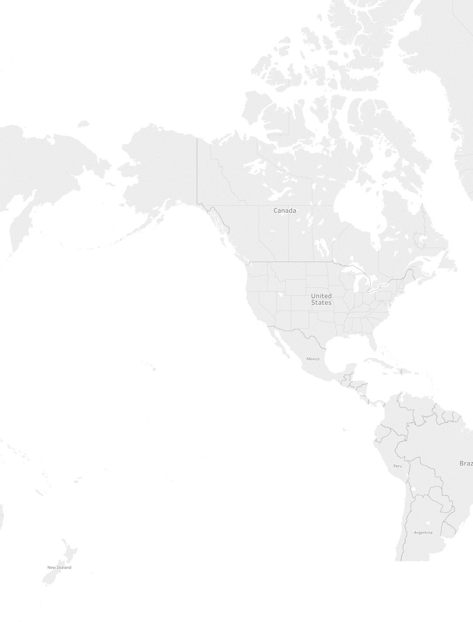

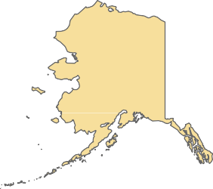

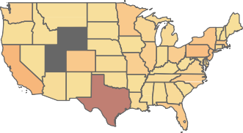
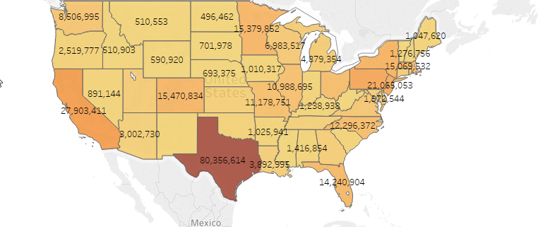
Geographical Aspect of Bike MS (5 Years)
Net Transaction Amount
10
1,322,042
Top 6 Corporations vs Net Transactions from Top Fundraiser States
Donor Employer
Net Transactions From Each State
BP Foundation |  |  |  | 1,322,042
Matching
Gifts
 |  | 177,628
TXH Anonymous Donor CIC | 1,011,304
Harmons | 752,865 | 10
 |  |  |  |  | 2,475
Fidelity Charitable Gift Fund |  |  | 690,552
 |  | 37,270
Johnson& Johnson Matching Gifts
 |  |  |  |  | 674,070
EOG Resources Matching Gifts
 | 544,244
461,035
8,506,995 _{510,553}
15,379,852
1,047,620
4,879,35416,864,643
12,104,945
2,519,777 _{590,920}
1,010,317
891,144 15,470,834
11,178,751
7,647,961
12,296,372
27,903,411
3,002,730
2,178,266
1,416,854
80,356,614
14,240,904
375,057
56,876
185

Slide 7
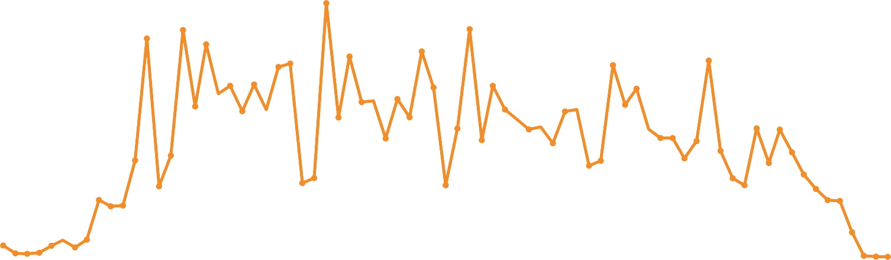
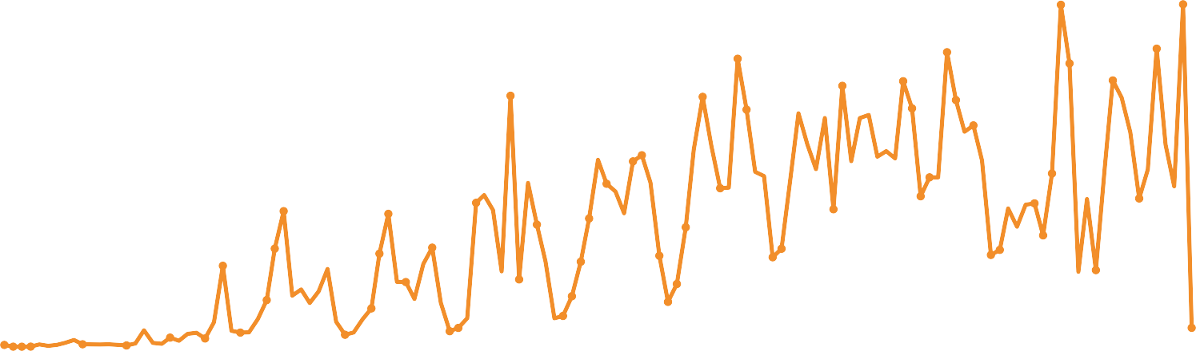
Total Participants Registration and Deregistration Monthly Analysis: (5 Years)
Total Participants Registered Each Month In The Last Five Years
Total Number Of Participants
11,312
10,595
12,648
11,352
10,886
9,991
10,244
10K
9,638
8,527
7,345 _{7,249}
6,352
9,556
9,788
8,527
9,467
8,443
7,581
8,382
8,592
7,260
7,716
6,949
7,869 _{6,402}
6,958
_{5,925 5,772} 6,403 6,344
7,496
5,209
4,104
5K
4,810
5,047
5,903
5,819
5,663
5,924
5,283
2,835
2,517
4,542
4,791
4,910
4,679
2,827
2,790
3,516
2,558
3,679
3,926
3,569
3,916
3,571 _{3,386}
565 ₁₅₁ 553
175205
1,222
10
0K
₄₆₉856
52
1
2012
2013
2014
2015
Month of Each Year
2016
2017
2018
Total Participants Who Opted Out Each Month In The Last Five Years
Total Number Of Participants
20K
19,637
19,665
16,541
16,915
_{14,985} 15,250
17,118
16,271
15,296
15K
14,414
14,352
13,618
13,690
14,166
12,711
9,951
8,234
10,646
11,000
10K
8,267
9,360
9,104
9,729
7,789
7,632
7,017
8,642
8,516
4,650
5,638
5,348
5,693
7,368
6,862 7,896
_{5,139} 5,631
5,565
6,397
5K
4,885
5,228
5,273
3,717
3,868
3,606
4,402
7 5 9
144 75
525
2,681
2,204
2,902 _{2,577}
1,770
0K
106
476 816
691
₈₉₄ 1,082
1,088
2006
2007
2008
2009
2010
2011 2012 2013
Month of Each Year
2014
2015
2016
2017
2018

Slide 8

Highest Fundraising Participants with Participant ID (5 Years)
59163651
₇₇₇₂₀₉₈₉75360997
52092498
48197872
43572493
75631462
53977268
59424275
44032290
41361141
46300884
59506848
87246516
44633560
40314668
75551622
43291682
61388735
45939886
58830418
45286368
56059634
59423390
Participant Member ID. Size shows sum of Net Transaction Amount. The marks are labeled by Participant Member ID. The data is ﬁltered on Exclusions (Net Transaction Amount,Participant Member ID) and Participant Member ID. The Exclusions (Net Transaction Amount,Participant Member ID) ﬁlter speciﬁes a set. The Participant Member ID ﬁlter excludes Null.

Slide 9
Bike MS in Last 5 Years
MeasureNames
TotalNumberofDonars TotalNumberofTeams
TotalNumberofEvents
TotalGiftAmount($)
NetTransactionAmount
TotalParticipantGoal($)
TotalNumberofParticipants TotalLedgerTransactions
TableName
2013Bike Donations.csv
TotalNumberofDonars
TotalNumberofTeams TotalNumberofEvents TotalGiftAmount($) NetTransactionAmount TotalParticipantGoal($) TotalNumberofParticipants TotalLedgerTransactionAmount
694,590
7,159
10 6
74,138,176
78,325,72
94,316
1,92 ,8 6,767
2014Bike Donations.csv
80,246,587
TotalNumberofDonars
TotalNumberofTeams TotalNumberofEvents TotalGiftAmount($) NetTransactionAmount TotalParticipantGoal($) TotalNumberofParticipants TotalLedgerTransactionAmount
651,628
6,828
107
74,687,131
78,924,629
90,073
2,098,569,676
2015Bike Donations.csv
79,487,484
TotalNumberofDonars
TotalNumberofTeams TotalNumberofEvents TotalGiftAmount($) NetTransactionAmount TotalParticipantGoal($) TotalNumberofParticipants TotalLedgerTransactionAmount
604,209
6,638
102
73,154,529
77,069,381
83,290
14,541,209,401
2016Bike Donations.csv
105,982,4 5
TotalNumberofDonars
TotalNumberofTeams TotalNumberofEvents TotalGiftAmount($) NetTransactionAmount TotalParticipantGoal($) TotalNumberofParticipants TotalLedgerTransactionAmount
539,939
6,323
97
6 6,162,842
69,4 5,792
73,078
1,813,950,83
2017Bike Donations.csv
97,408,325
TotalNumberofDonars
TotalNumberofTeams TotalNumberofEvents TotalGiftAmount($) NetTransactionAmount TotalParticipantGoal($) TotalNumberofParticipants TotalLedgerTransactionAmount
494,948
5,794
84
61,252,951
64,261,391
66,605
1,674,975,381
64,716,361
9B 10B 1 B 12B
Value
0B 1B
2B
3B
4B
5B
6B
7B
8B
13B 14B 15B 16B
17B 18B 19B 20B

